Slide 1


Yolo V7 for industry object detection application
AI
Theerawat 9 Sep 2022

Slide 2
Yolo V7 for industry object detection application
Inspiration:
Yolo V7 is the AI Vision opensource software which delivers the best performance both accuracy and speed yet easy and make most sense ever of development environment which key trigger of the deployment. Yolo V7 is also available from single broad computer like Jetson nano onward which suitable for low cost project such AI at the Edge application.
Topic:
Introduction: What is YOLO ? Who is Inventor ?
Installation: Requirement
Pretrain model Inference demo
Custom model development demo

Slide 3
Yolo V7 for industry object detection application
Introduction: What is YOLO ? Who is Inventor ?
https://pjreddie.com/darknet/
https://www.youtube.com/watch?v=Cgxsv1riJhI
https://pjreddie.com/resume/
https://github.com/WongKinYiu/yolov7

Slide 4

Yolo V7 for industry object detection application
Installation: Requirement
CPU ARM or x86
GPU nVIDIA (option for Custom Dataset Model Training)
OS 64 Bit
Python 3.8 Environment such as Anaconda
Source code https://github.com/theerawatramchuen/yolov7
Procedure:
Create Python 3.8 with anaconda
conda create -n yolov7 python=3.8
conda activate yolov7

Slide 5
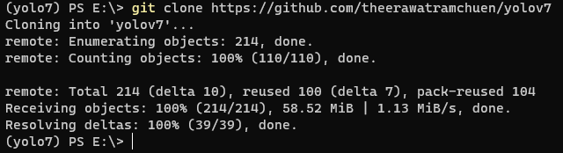

Yolo V7 for industry object detection application
Procedure:
Clone source code from github
git clone https://github.com/theerawatramchuen/yolov7
cd yolov7

Slide 6
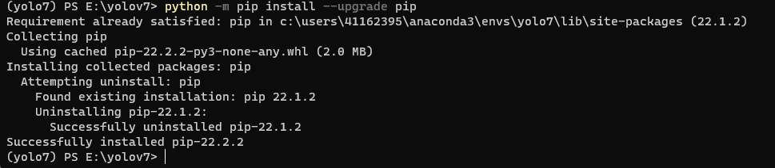
Yolo V7 for industry object detection application
Procedure:
Update Installation Software
python -m pip install --upgrade pip

Slide 7
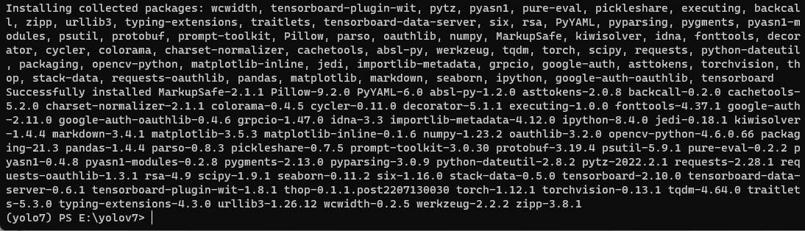
Yolo V7 for industry object detection application
Procedure:
Install yolov7 to our machine
pip install -r requirements.txt
Download pretrain model to {yolov7} folder (option)
https://github.com/WongKinYiu/yolov7/releases/download/v0.1/yolov7.pt

Slide 8

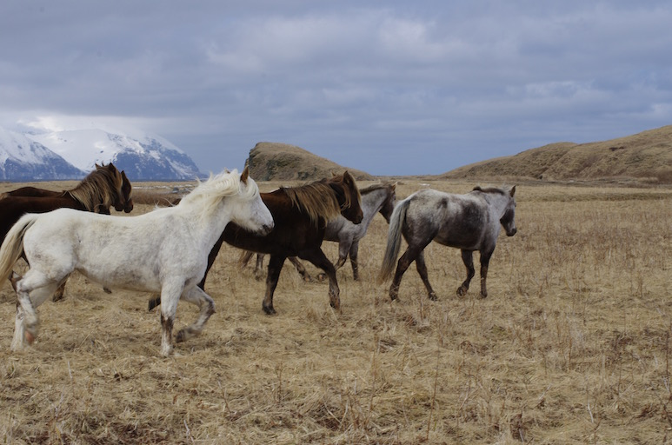
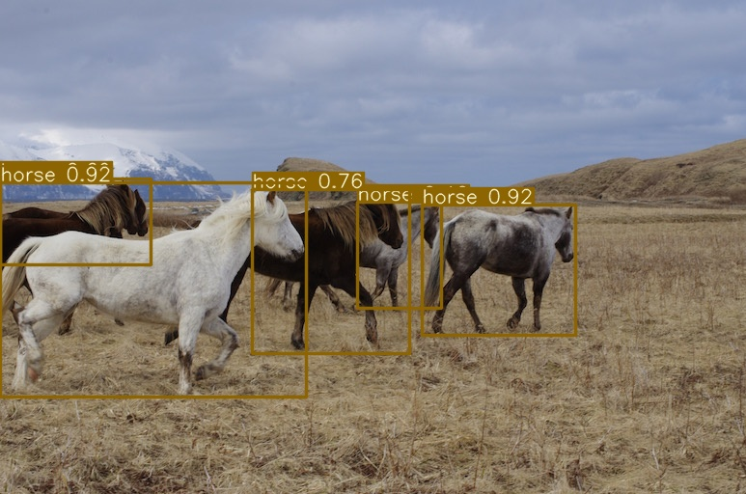
Yolo V7 for industry object detection application
Procedure:
Verify Installation
python detect.py --weights yolov7-tiny.pt --source inference/images/horses.jpg --img 640
Output images
Input images

Slide 9
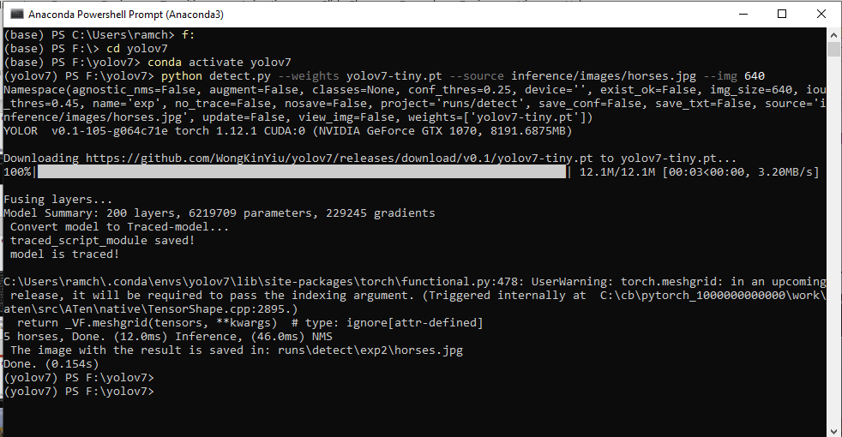

Slide 10
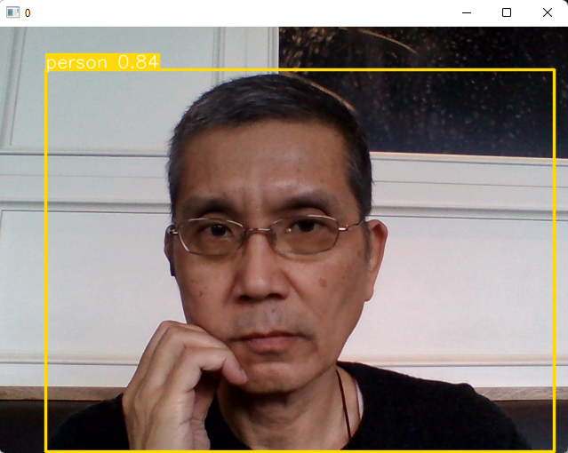
Yolo V7 for industry object detection application
Pretrain model Inference demo
Live inference with web-cam id 0
python detect.py --weights yolov7-tiny.pt --source 0 --img 640
Input USB web-cam ID 0
Live Output on Screen

Slide 11
Yolo V7 for industry object detection application
Custom model development demo
Collect data
Label data
Split data (train & test)
Prepare config files
Start training (Need GPU nVIDIA)
Use custom model

Slide 12
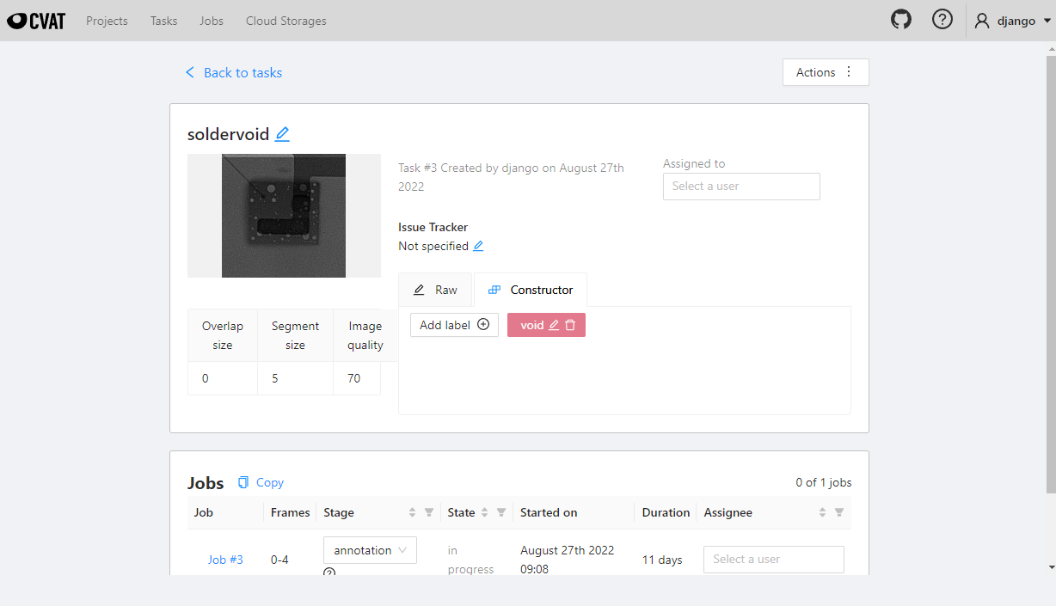
Yolo V7 for industry object detection application
Custom model development demo
Collect data

Slide 13
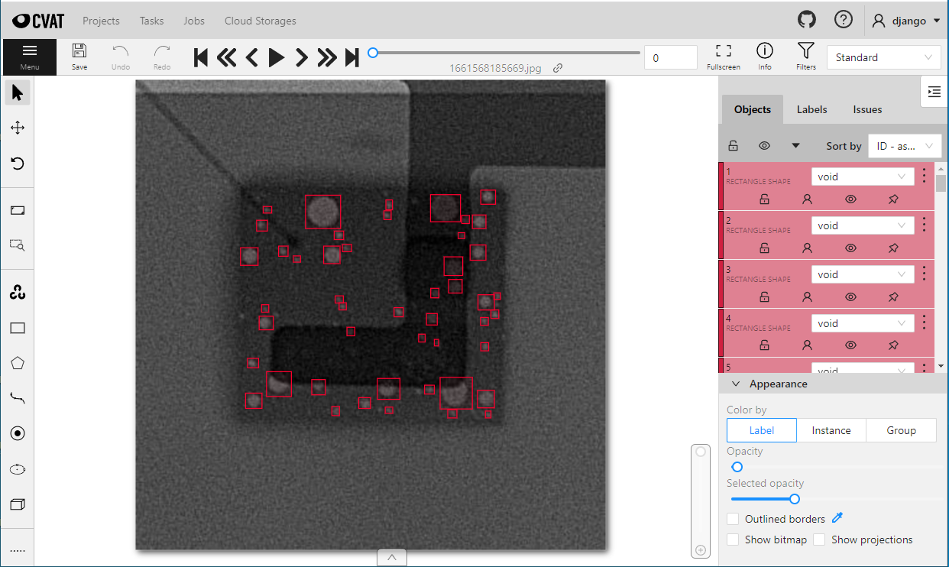
Yolo V7 for industry object detection application
Custom model development demo
2. Label data

Slide 14
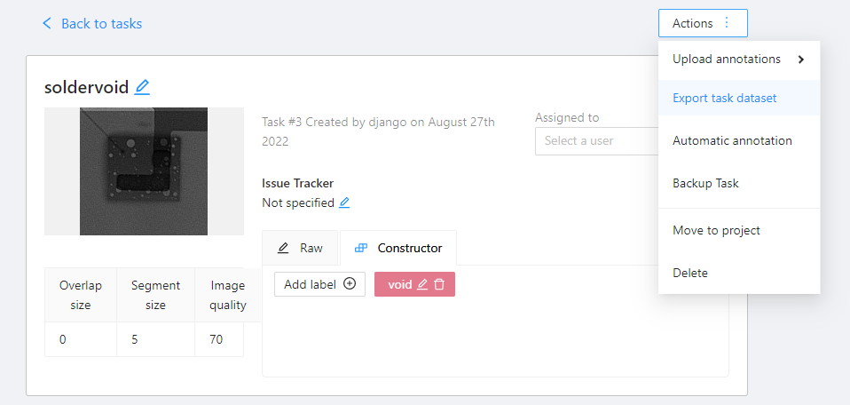
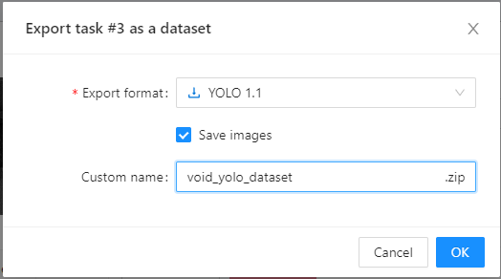
Yolo V7 for industry object detection application
Custom model development demo
2.1 Export from CVAT in Yolo format

Slide 15
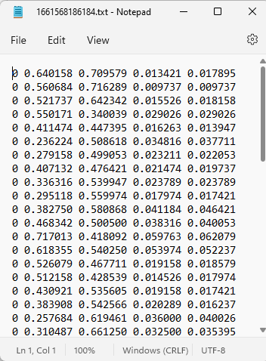
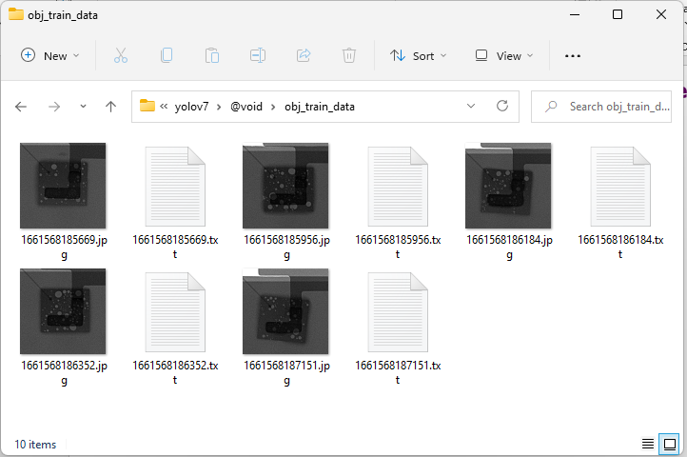
Yolo V7 for industry object detection application
Custom model development demo
2.1 Export from CVAT in Yolo format

Slide 16
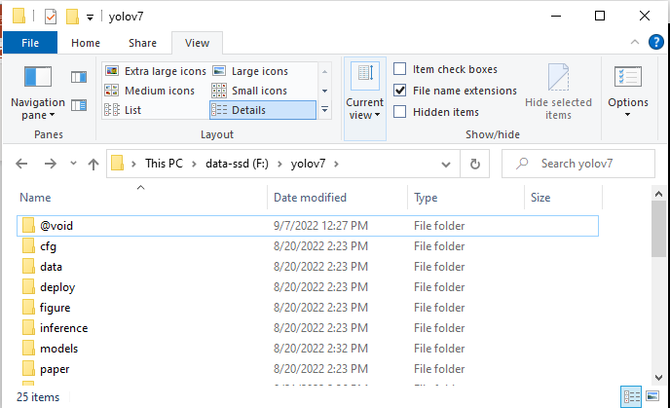
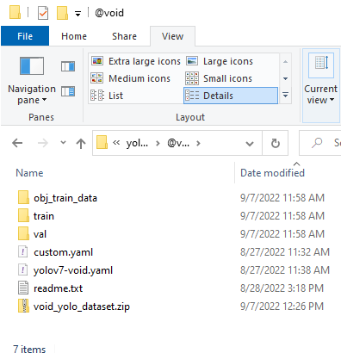
Yolo V7 for industry object detection application
Custom model development demo
3. Split data (train & validate)

Slide 17
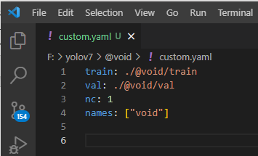
Yolo V7 for industry object detection application
Custom model development demo
4.1 Create config files “custom.yaml”
train = directory of train images with labeling files
val = directory of validation images with labeling files
nc = Number of classes
names = Project name

Slide 18
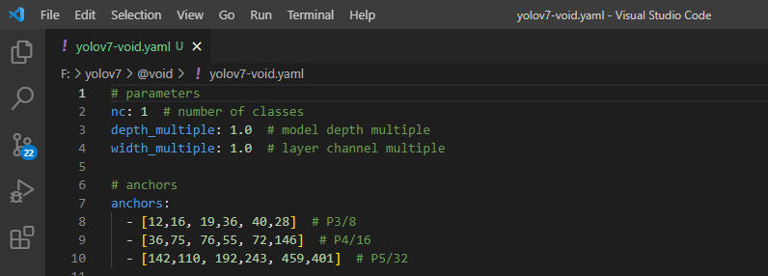
Custom model development demo
4.2 Edit model “yolov7-void.yaml” file for require number of class {line #2}

Slide 19
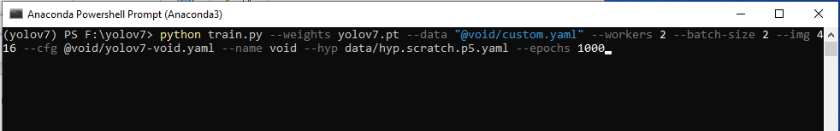
Yolo V7 for industry object detection application
Custom model development demo
5. Start training (Need GPU nVIDIA)
# Script for model development## Training the model
$ cd yolov7
$ python train.py --weights yolov7.pt --data "@void/custom.yaml" --workers 2 --batch-size 2 --img 416 --cfg @void/yolov7-void.yaml --name void --hyp data/hyp.scratch.p5.yaml --epochs 1000

Slide 20
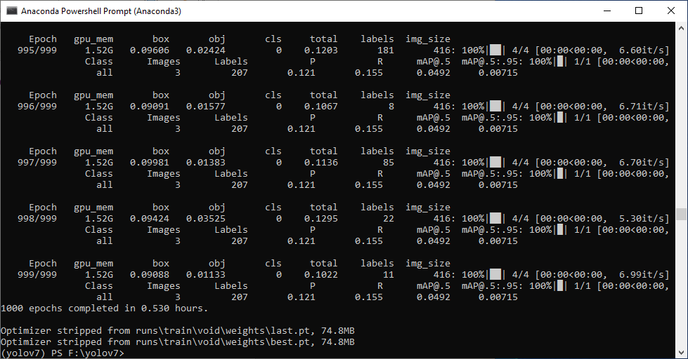
Yolo V7 for industry object detection application

Slide 21
Yolo V7 for industry object detection application
Custom model development demo
6. Use the custom model
## Inference with new model
$ cd yolov7
$ python detect.py --weights runs/train/void/weights/best.pt --conf-thres 0.7 --source @void/obj_train_data

Slide 22
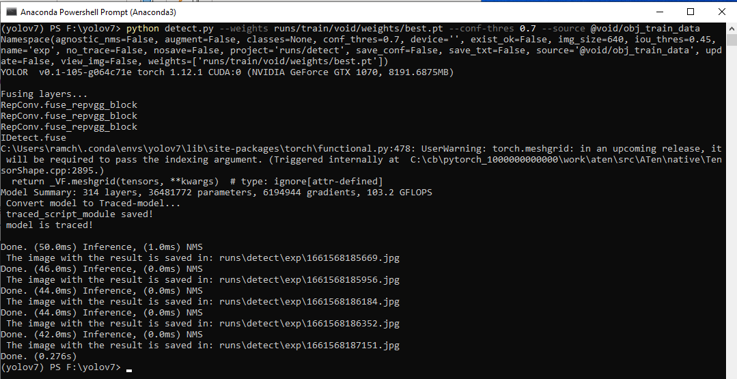

Slide 23
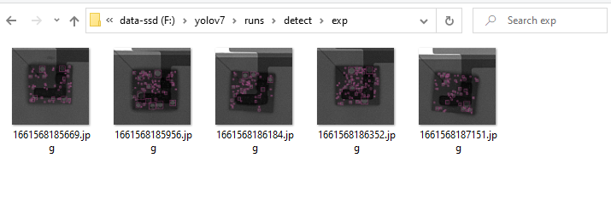
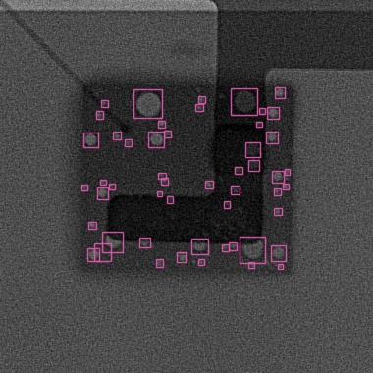

Slide 24
Appendix

Slide 25

Custom AI model Training input compared to Human knowledge development
Custom AI model Training inputs | Human knowledge development | Comment
weight files {filename.pt} | Background knowledge Primary school, Bachelor , Master etc. | Weight file must be corresponding with cfg file.
train images {folder of train} | Text Book , Information or other material to gain specific knowledge
valid images {folder of valid} | Examination to validate knowledge score
worker, batch-size, image {numeric} | Time to finish the studying of the course | Time to spend for learning per day. More time spend per day is shorter learning period of time
cfg {filename.yaml} | Brain cells volume, Age | Yolov7 has 37M cells

Slide 26
Custom AI model Training input compared to Human knowledge development
Custom AI model Training inputs | Human knowledge development | Comment
name {ai model name} | Name of specific knowledge or Subject name
hyp {hyper parameters} | Tutor’s technic to get learning curve real quick. | tutor’s technic can not help improve your learning every case.
epoch | Exercise | More exercise gain more accuracy

Slide 27
